Slide 1
EMPLOYEE MANAGEMENT SYSTEM
By Surya Bansal
7th A
1420147

Slide 2
INTRODUCTION TO PROJECT
Its a employee information handling tool.
Its best feature lies within its simplicity in design and easy to use & understandable functions.
Its has all the basic features to maintain a record keeping system
Its extra feature is that we can export the entire database data into excel sheets.

Slide 3
Options the project provides :
Adding a record (which will eventually be stored in two different tables in database)
Updating a record (EMP_ID is the primary key constraint in all option)
Search a record
Delete a record
Display the whole data
Export the data to an excel sheet

Slide 4
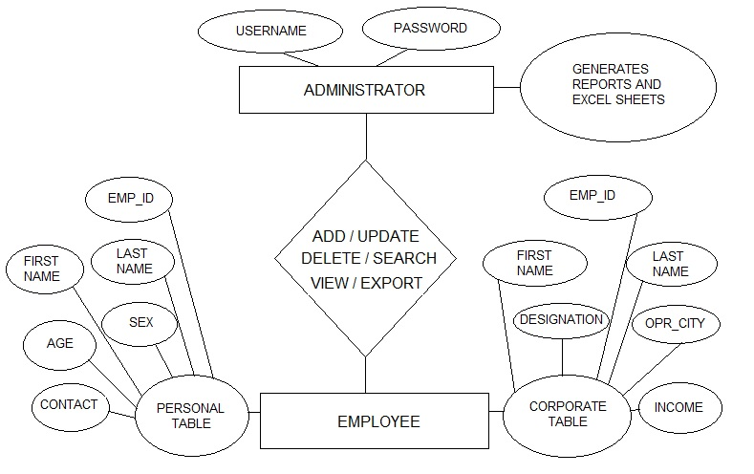
DATA FLOW DIAGRAM

Slide 5
SNAPSHOTS

Slide 6
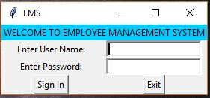
LOGIN PAGE

Slide 7
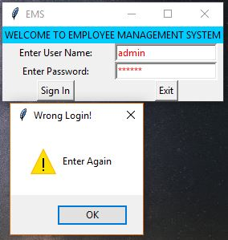
ERROR!

Slide 8
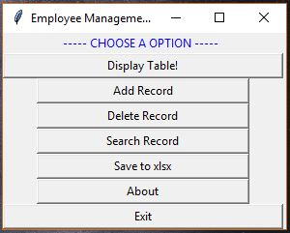
FRONT PAGE

Slide 9
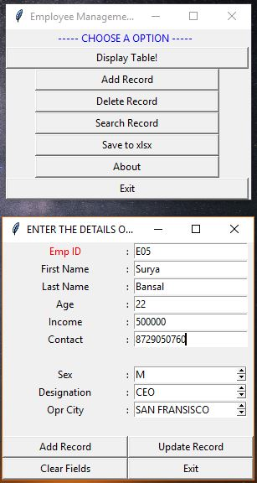
ENTERING DATA

Slide 10
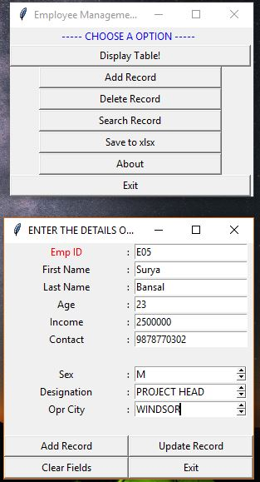
UPDATING DATA

Slide 11
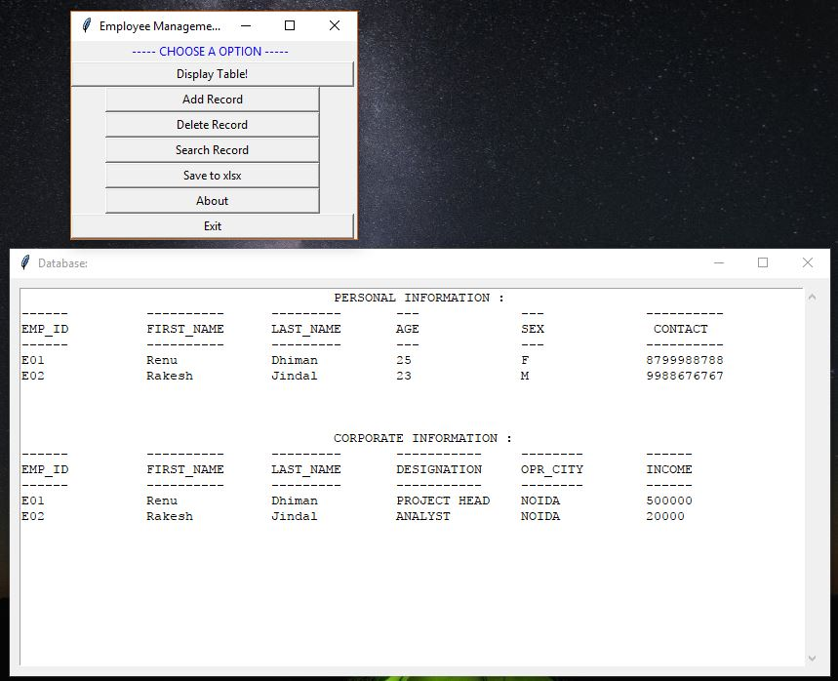
DISPLAYING ALL THE DATA

Slide 12
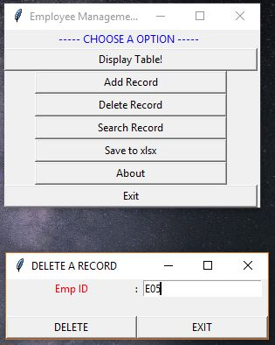
DELETING A RECORD

Slide 13
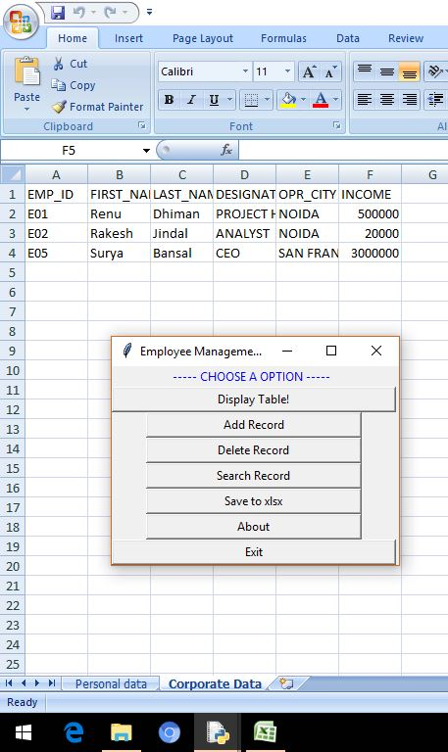
EXPORTING DATA TO EXCEL SHEETS

Slide 14
Working with XAMPP: XAMPP stands for (X) Cross-Platform (A) Apache (M) MariaDB (P) PHP (P) Perl

Slide 15
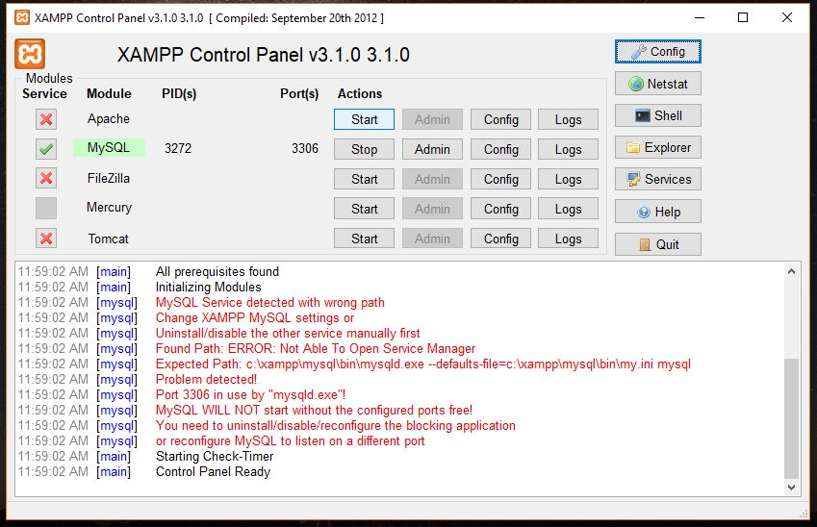

Slide 16
Thank you

